Slide 1
Graffiti AI Amplifier get the message out © 2016-2025
CONFIDENTIAL
Pingblender CPG Case Proposal

Slide 2
CONFIDENTIAL
Problem Statement:
Marketing workflow is complex and inefficient
Identity management presents risk to efforts
Customer messaging is global, and cumbersome
Reactive personalization underperforming
Data is governed in multiple regions
Solution Objective:
Create intuitive workflow controls to manage multiple owners across lanes and organizational barriers.
Produce a secure ephemeral container which can manage ‘Identities’, PII and if needed, PCI
Enable agency of multiple-language interfaces for handling challenges with organization breadth, as well as effective consumer messaging.
Allow for local controls (in-network) of client data treatment and syndication per regional requirements
[Confidential] Graffiti© Mimeograph Holdings, LLC 2016-2025 – All rights reserved.

Slide 3
CONFIDENTIAL
GOVERNING PHILOSOPHY
Graffiti is this world’s oldest of enduring means of communication. Long before Sumer or Persia, the Toltecs or the ‘New World’ – humans, have left messages which will exist beyond their speaking, to the generations. Isolated, possibly by weather or natural event, possibly the need to survive predatory animals, some being picked up a rock or burnt wood and started depicting a message by projecting their ideas onto a cave or stone wall. These paleolithic panels and storyboards remain, and inspire, the need to return to our ability to create and endure, and evolve, with the changing landscape of our digital medium and the dawn of general Artificial Intelligence.
The single reason we chose to name our technology Graffiti is that we want to empower our generation grow a society and a civilization which is comfortable with and gaining efficiency by the use of our models to help craft ideas, build visions, or solve day-to-day problems, make better decisions, even use it to tell our family stories or to close the gaps created by mental health or anxiety by helping add dimensions of perspective. They should do this inexpensively, safely, privately, and with assurances of transparency, and compliance.
Mimeograph Holdings presents Graffiti – a FIRST user-experience in AI adoption for anyone, anywhere, any time; without the complicated problems of 7 billion opinions or 40,000 years of semantic noise.
Graffiti (Mimeograffiti) is an Open-Source, responsibly profitable, and ethically devised PaaS offering which through a unique networking approach, can safely live inside your homes or inside our companies, without the need for any export or transfer of personal, health, or financial data to ANY third party. The steps we take now to set the tone and the character of the ‘Age of Intelligent Machines’ will remain on the walls of the inversion which we enlist to augment our human potential.
[Confidential] Graffiti© Mimeograph Holdings, LLC 2016-2025 – All rights reserved.

Slide 4
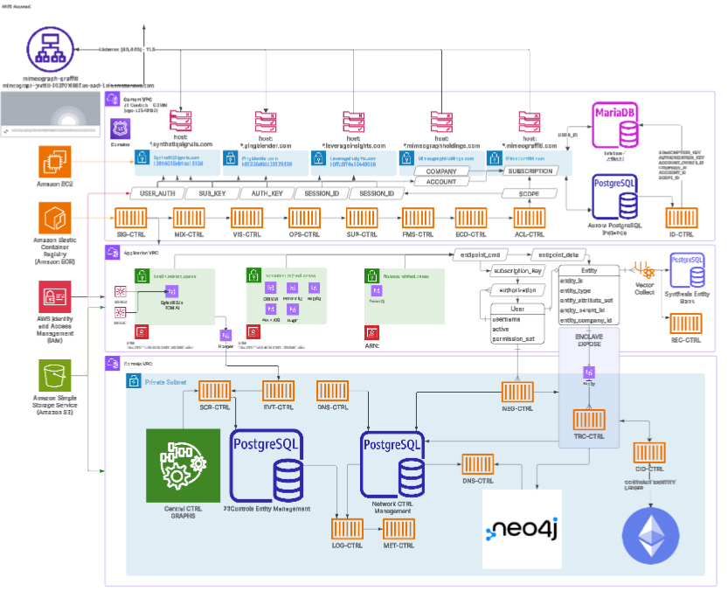
Meet and exceed compliance expectations: 23Controls Principle
We will build and foster AI in our own likeness.
There are 23 separate pairs of genes which comprise the human DNA which control the traits and potential of the way we build our lives and means by which we receive, use, and produce information in the world.
The methods and mechanisms beneath the surface of the Graffiti AI Amplifier adhere to the simplicity of design in that each separate control is individually tasked with a single job of making sure the throughput of the information is as ‘understandable’ as possible for our systems efficiency and success. Rather than go about preaching about these principles, we decided to dedicate a layer of our A2A (Agent to Agent) network of data management was to build it into the base Graffiti Framework, allowing for versatility in many fields, capable of receiving and using nearly any stream of data to create input to our RAG Embeddings Collections.
Graffiti AI Amplifier leverages 23Controls to produce reliable input governing a traceable source control within a complex plane of collections and purposes. This helps generate ‘Case Versatility’ which is the core of what we’re trying to promote – AI for nearly ANY purpose doesn’t need to be complicated to access, or expensive to produce value.
CONFIDENTIAL
[Confidential] Graffiti© Mimeograph Holdings, LLC 2016-2025 – All rights reserved.

Slide 5
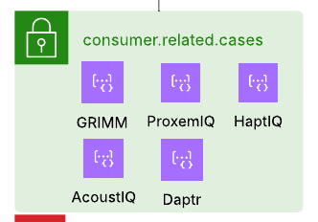
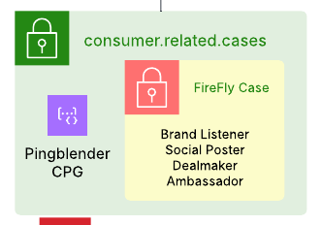
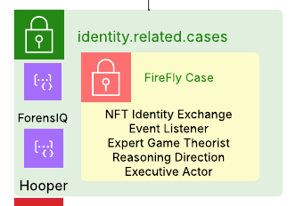
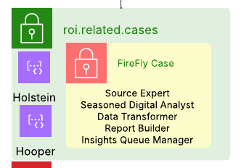
Pingblender© CPG
CONFIDENTIAL
Customer Benefits
Case 1: CPG Brand Coverage for Marketing Production and Personalization
Pingblender CPG is the solution to the complex mess of transformation and coordination that takes place over the lifecycle of the message economy surrounding popular products and incentives. Quickly handle approval via workflow agents and leverage capacities of expertise informed ‘Agents’ to carry out functions interpreting the CPG economy in one or many product flagships, across the world. Make personalization relevant nuancing messaging with regional dialects, while targeting attributes to hydrate the RAG.
Workflow Agents
Brand Czar
Identity A2A Panel
Analytics ROI Cycle Panel
Data is user-provided to the 23Controls unit mounted into the local network, and controlled locally ONLY by authorized parties, and is Zero-Trust by Design.
Data is fully encrypted, using myriad algorithms – and is ONLY stored in raw form on the Graffiti Container, running on 23Controls. IT NEVER LEAVES HOME.
A cleaned and normalized construct of a vector store is used by the underlying Large Language Model subscriptions to inform the detail and nuance
Data in the form of several inputs is used to craft conversation, and recommendations to the user, qualify its recommendations, and quantify the confidence of the advice.
Chat: Grimm
Show Materials
Upload Files
Connect Accounts
Orchestration
Feedback
Quality of the recommendations and advice are regularly traced, trained, and tuned to assure that the best mix of subjective advice and LLM Support are considered.
[Confidential] Graffiti© Mimeograph Holdings, LLC 2016-2025 – All rights reserved.

Slide 6
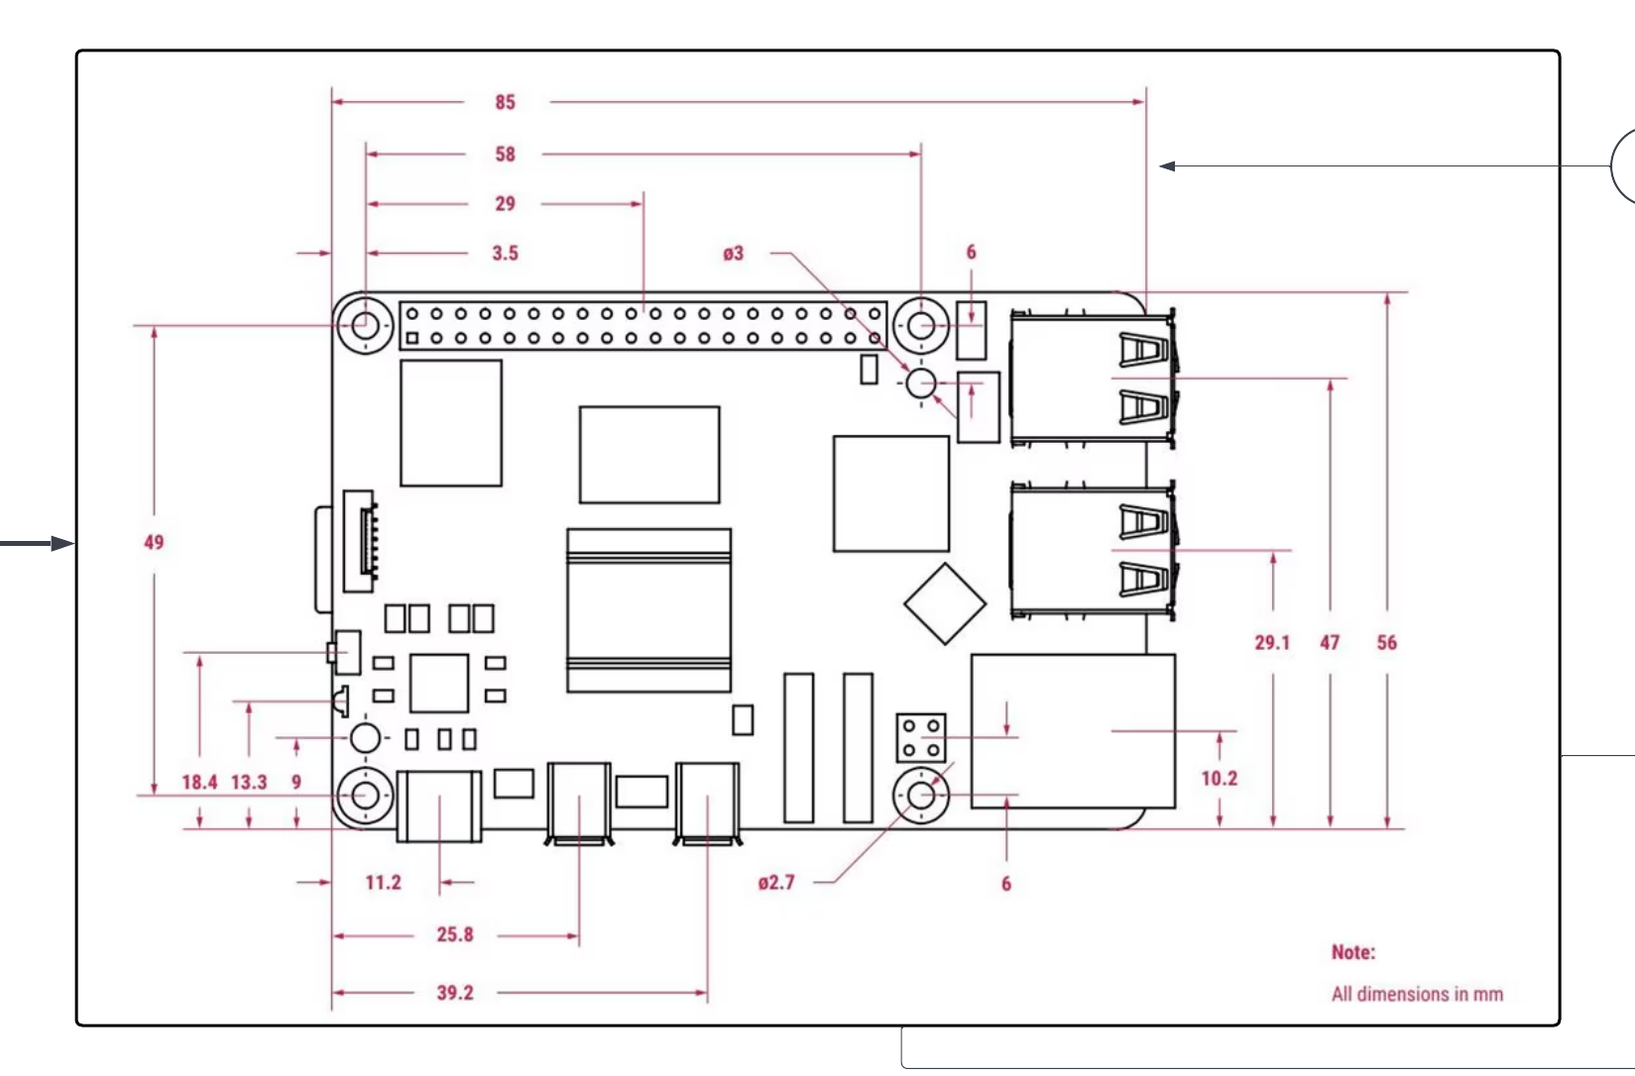
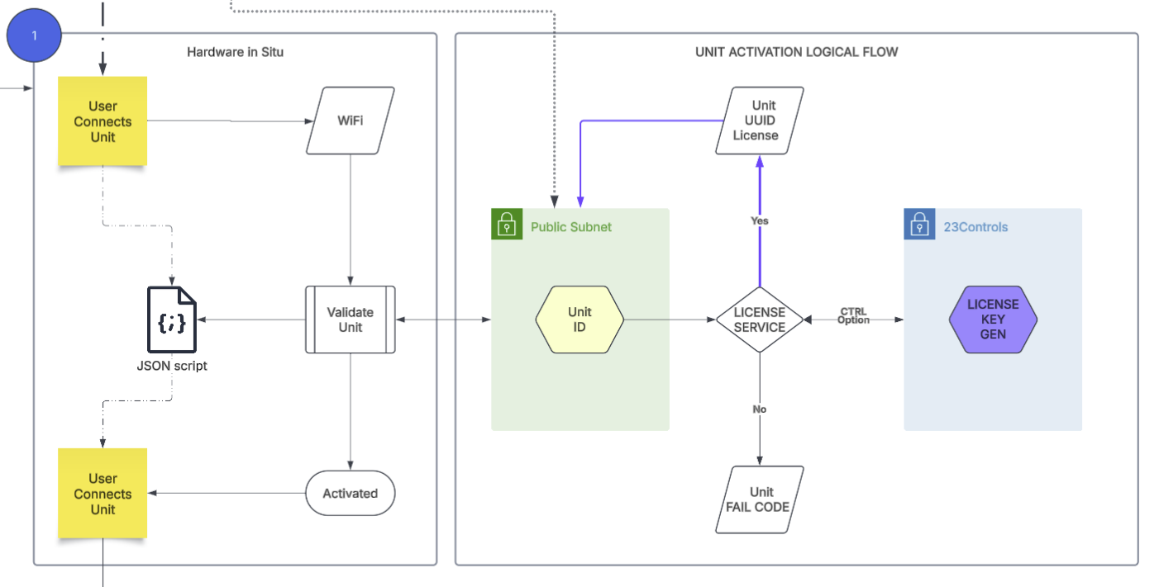
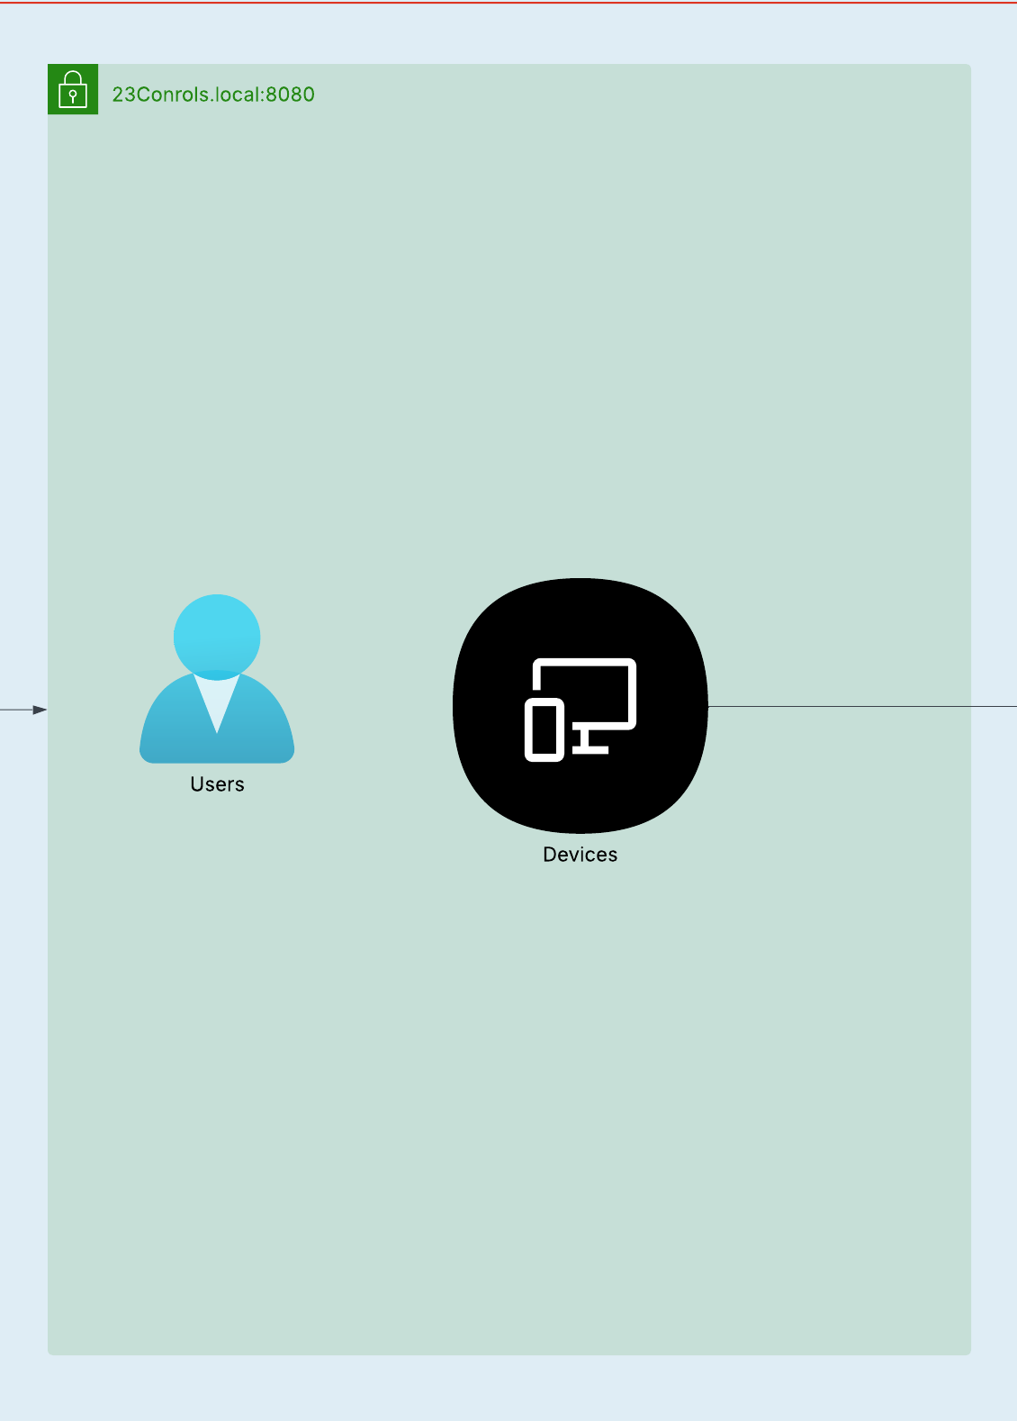
Meet the Scrambler
CONFIDENTIAL
In the same vein as a game console for your use with DLC, cartridge, or disc: Scrambler handles the hard part of getting Generative AI running for your individual or organizational use. Just like a plug and play unit, with secure access to models and markets where you can drop and modify objects to define primary functions of the AI Entity secured with constructs and feedback cores to help you work easier with it. The unit is inexpensive by design, to help assure that the world has a say in how it wants to interact with AI.
Scrambler is outfitted with key base modified OS for deployment.
Activate Graffiti Amp Record Initiate Scrambler Imaging Configure Cloud Integration 23Controls Run Unit
The key features include:
A Deployment package (micro-application) which proceeds through the setup.
A Security Package – which helps assure that the localized data and the cloud data are in Enclave
A Cloud Package – this assures seamless and simple integration into key cloud architectures (AWS/Azure)
Graffiti AI Amplifier – this is a local network client interface for the AI Services and A2A Workflows.
Data Controls Interface – 23Controls runs a container for local normalization, sector services & collections
SynthetIQ Signals Account
[Confidential] Graffiti© Mimeograph Holdings, LLC 2016-2025 – All rights reserved.

Slide 7
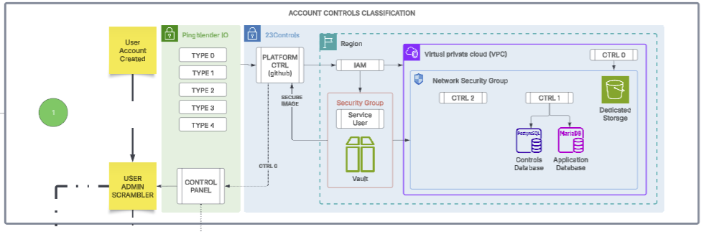
CONFIDENTIAL
SIMPLE CLIENT ACTIVATION : Configure the unit scope and address regional data limitations.
An account created on any of the properties will allow for configuration based on a series of rules and interactions with the agents on the federated application cores. These will help to promote agent coverage in cases across the organizational goals and objectives, and in complex regulatory spaces, without having to adapt or update firewall rules to accommodate DEPLOYMENT.
[Confidential] Graffiti© Mimeograph Holdings, LLC 2016-2025 – All rights reserved.

Slide 8
CONFIDENTIAL
SIMPLE CLIENT ACTIVATION : Configure the unit scope and address regional data limitations.
With a proper activation code (ETH NFT Token validated on chain) the Graffiti Scrambler unit will have the ability to connect and interface with the underlying Cloud Infrastructure via build instructions and subscription IAM roles. Scripts execute to build out the unit synthetic cloud connections for storage and processing the CICD Containers on a democratized but controlled and secure environment.
[Confidential] Graffiti© Mimeograph Holdings, LLC 2016-2025 – All rights reserved.

Slide 9
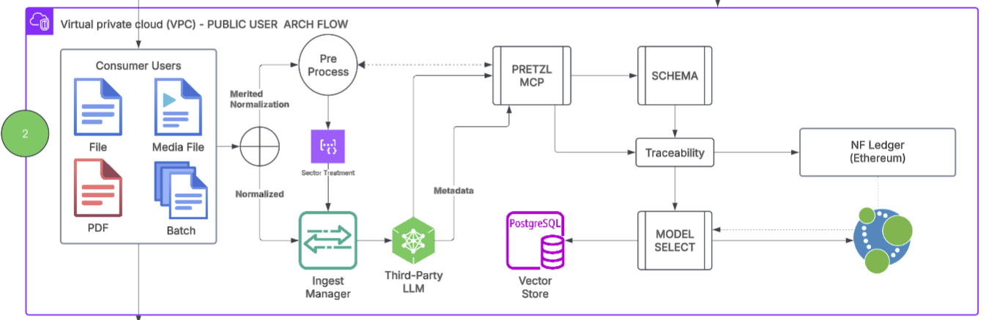
CONFIDENTIAL
SCALING CLOUD DEPLOYMENT: Application Functions with MCP Access Across the User Plane
Data which is shared into the RAG for use with PRETZL MCP store vectors in a LOCAL PGVector instance when the client is onboarding and activating. When the actions are complete at that phase, the user can choose to syndicate to the CLOUD for use by other seats on the license, or, can be stored abstractly for use with learning feedback systems built by sharing syndicators on the larger network. Each input to the system, and every output from the system is known, even when the ephemeral ‘Container’ is broken down; but only accessible by contractually protected clauses on the Ethereum Main chain.
[Confidential] Graffiti© Mimeograph Holdings, LLC 2016-2025 – All rights reserved.

Slide 10
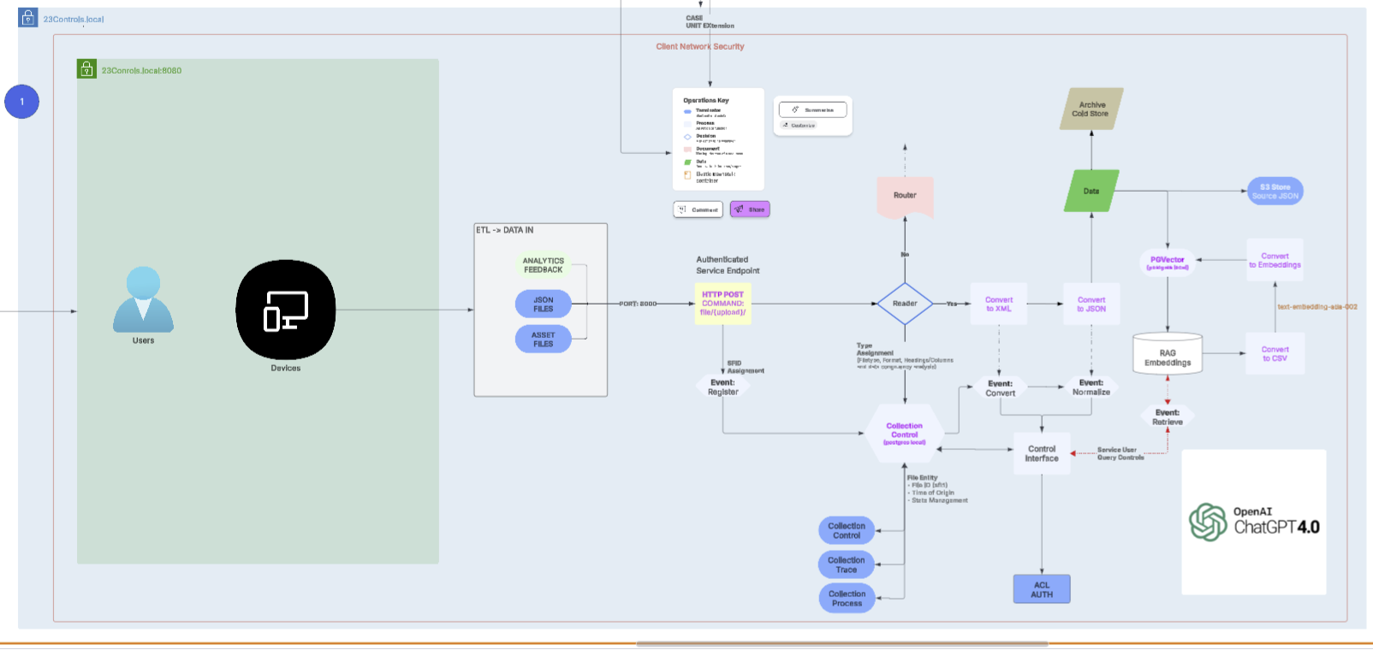
CONFIDENTIAL
SIMPLE CLIENT ACTIVATION : Graffiti Scrambler Unit Data Flow
[Confidential] Graffiti© Mimeograph Holdings, LLC 2016-2025 – All rights reserved.

Slide 11
CONFIDENTIAL
AI Agentic Workflow: Articulate real-world workflows to carry out the steps to generate Ad Content to Spec
[Confidential] Graffiti© Mimeograph Holdings, LLC 2016-2025 – All rights reserved.

Slide 12
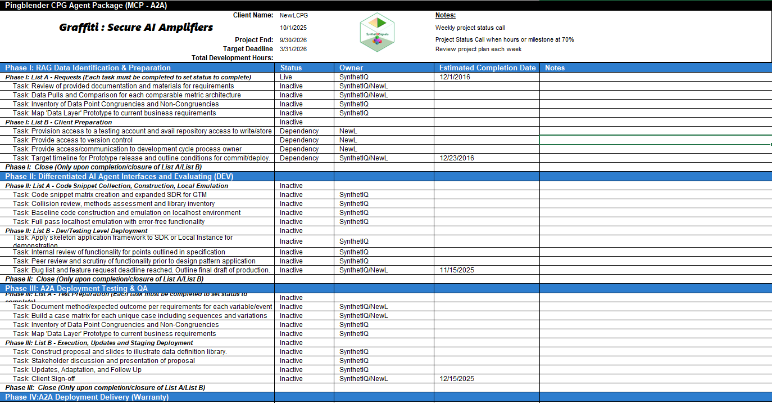
CONFIDENTIAL
Expert Implementation & AI Agent Training Project Plan (Phases)
HOLDING

